Slide 1


Linux and Shell Scripting
Dr. Sheikh Umar Mushtaq
Assistant Professor

Slide 2
Introduction to CAP 269
Manual Partitioning
LILO Booting

Slide 3
Creating Files
Step 1: What is Partitioning?
When you install Linux on a hard disk, you divide the disk into partitions (like sections of a notebook).
Example:
/ (root) → main system files
/home → user files
swap → extra memory support
Partitioning decides where Linux will store its files.

Slide 4
Mounting a Disk/Partition
Step 2: What is LILO?
LILO = Linux Loader (old boot loader).
It is like a menu that appears when you start your computer.
Today, GRUB is used instead of LILO, but for learning basics, LILO is still taught

Slide 5
Step 3: Main Purpose of the Practical
👉 The practical is about understanding two things:
Choosing partitions during Linux installation (deciding which part of the hard disk to format and use).
Using LILO to boot Linux (how Linux starts after you power on the system)

Slide 6
Step 4: What You Can Do in VMware
Since we already know how to install Red Hat Linux on VMware:
During installation, when asked to partition, show how to create /, /home, and swap partitions.
without partitions, Linux won’t know where to store system files.
LILO (or GRUB in modern systems) is installed in the MBR (Master Boot Record), which lets the system boot Linux after power on

Slide 7
How you configure & show LILO Since in most Red Hat setups GRUB is default, to show LILO you do:
During installation, there is a step “Boot Loader Configuration”.
Select LILO instead of GRUB (if installer allows).
Choose where to install:
MBR (Master Boot Record) → /dev/sda
Or First Sector of Boot Partition → /dev/sda1

Slide 8
After installation, reboot → system shows the LILO boot menu. Example:
LILO boot:
Here you can type the label (like linux) to boot.

Slide 9
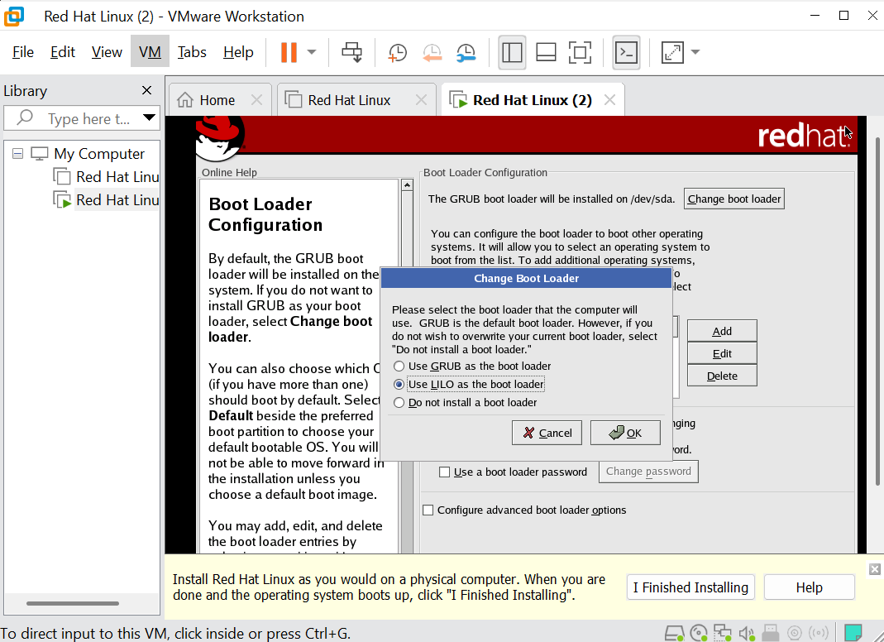

Slide 10
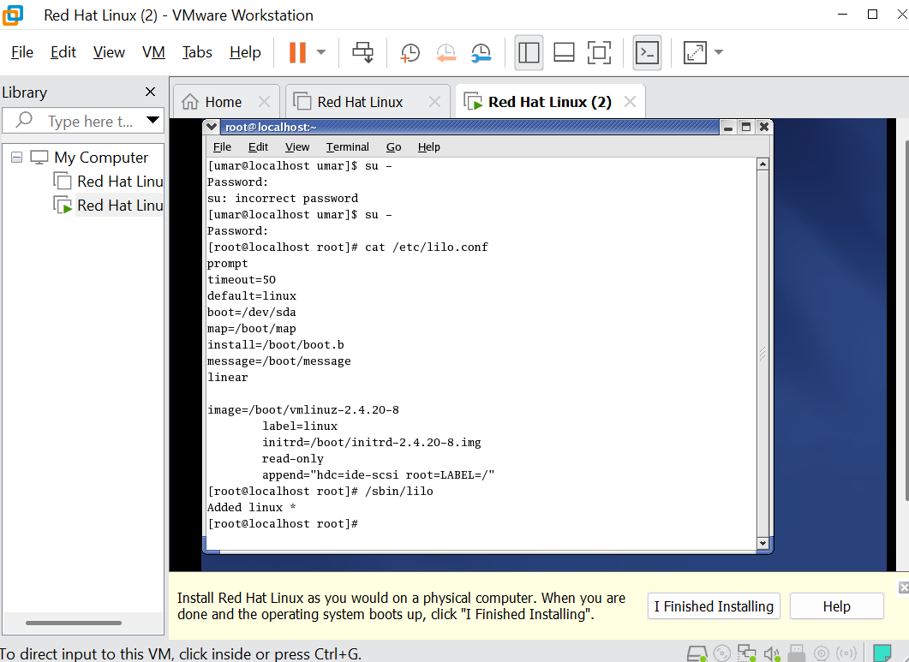

Slide 11
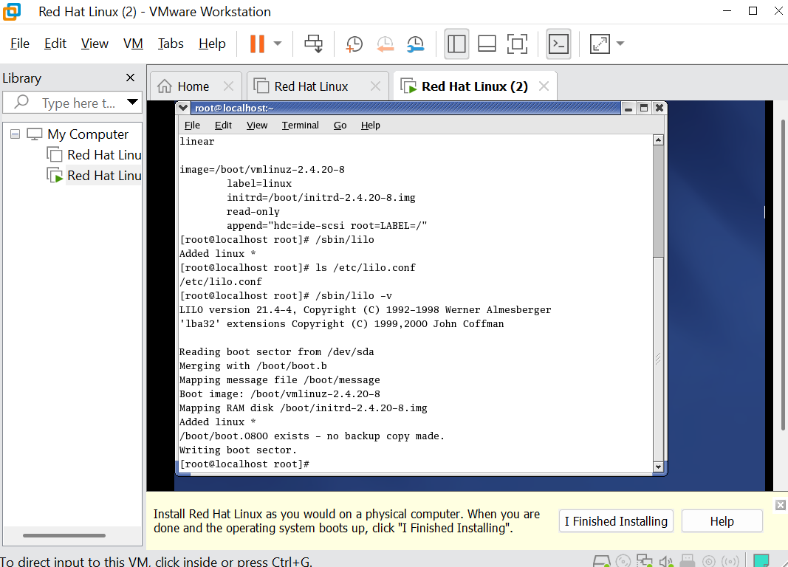

Slide 12
